Slide 1
SUBCONSCIOUS RECALL IN 3D
Sculptures by Girijaa Upadhyay
© Girijaa Upadhyay . All Rights Reserved

Slide 2
SUBCONSCIOUS RECALL IN 3D
The 14 sculptures presented here, are an expression of subterranean perceptions of the Universe, its diverse elements and forces, Man and his umbilical link with the Universe, of connections with various biorhythms that surround him and of feelings. They are a tribute to the elements Wind and Water, to the Earth, and to the wondrous Universe, maybe tinged with some awe .
These sculptures are born from an amalgam of an enduring fascination for the Universe and Nature, for Science and History; Sound, Movement and Visuals. Some came out of a chuckle and some out of quiet reflection. Geometry was the able tool. Some of the sculptures scaled up are equally adaptable for use in community spaces, enhance urban landscapes, while some might also be appropriate for conveying institutional motifs.
© Girijaa Upadhyay . All Rights Reserved.

Slide 3
SUBCONSCIOUS RECALL IN 3D
The sculptures presented here are:
Float/ Hydraulix 1 and 2, Aerosync/Ballet of the Winds,
Eon,
Atlantis Rising,
Tree of Life,
Mind Mantra Troika,
Revelation,
Chotu and Friends,
Blue Rhapsody,
Jive
His Excellency- from Gastronimica,
Cubes Gallery
Aasra- The Circle of Giving.
Lotuses: Padma & Patra
Utpala
© Girijaa Upadhyay

Slide 4
Float Hydraulix
These sculptures are a salutation to the power of the elements – here, the force of water. What better place than the Himalayas , to be humbled by the masterpieces of the elements, the grandeur of the mountains, the many forms of water, from the bubbling streams to roaring kunds and the evocation of a majestic symphony like that at Rudraprayag, with the emergence of the Ganges from the confluence of thundering tributaries, fanning out as deep and powerful waters. Hydraulix is an attempt to depict the underlying power of the waters to move mountains, icebergs, rocks small and large. Viewed from the side and the top, all the pieces small and looming large, are being swiftly propelled to their ultimate destinations by the silent but powerful force of the waters. . Their motion is almost one of single minded purpose! As if they have just their journey on their minds. While Water, actually holds the rudder in its hand. The quiet force. Water - the Janus faced element-sometimes roaring and thundering, sometimes fathomless quiet.
Float 1 is made from pink Makrana marble. Float 2 is made with Katni marble, with its beautiful veins. Lit with candles in the crevices, the stylized sculptures take on a dramatic look and one might feel the power of the elements?
Dimensions: Height: 24” Breadth: 24” Depth: 12”
© 2007, Girijaa Upadhyay

Slide 5
Aerosync / Ballet of the Winds
Aerosync/Ballet of the winds capitalizes on the fluidity of the metallic
flows in steel and copper, to depict the various rhythmic motions of the
wind, as it blows, sweeps, curves, zooms and twirls seamlessly through
any resistance, depicted here like a sail billowing out with their fluid
force. The movements of the wind echo those in various dance forms as
ballet, the jumps- assemble allegro; bharat natyam -natraja and
yoga -bhujanga pose. Aerosync is a simplistic display of aerodynamics.
At another level it is a symbol of the beauty of fluid movement.
Dimensions: Height: 28” Breadth: 20” Depth: 20”
(Metal- stainless steel and copper)
© 2009, Girijaa Upadhyay

Slide 6
EON
Eon is a symbolic depiction of the experiences of the Earth and the Universe in the process of their creation. The sculpture echoes those billions of years of various processes of torsion and temperatures- of friction, fissures, shifting of tectonic plates, disintegration and unison, great heat and cold, discord and harmony, which resulted in the Universe in its present form. The use of symmetry and asymmetry, fracture and alignment and the crescendo structure – is also symbolic of the human spirit. Eon is a tribute to the Universe, in admiration of its vastness and beauty, no less a parallel to the human spirit in Life. Through this creation the artist wants to bow to the vastness of the Universe and to Man , however tiny, in it.
Dimensions: Height: 21 Breadth: 31” Depth: 28” apprxmly.
(Green marble tiles)
Copyright © 2007 Girijaa Upadhyay

Slide 7
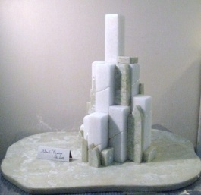
Atlantis Rising
The emergence of the lost city of Atlantis from the pearly ocean in
Atlantis Rising is symbolic of the resurgence, resilience of the
Human Spirit. The onyx marble has been selected to depict the
churning of the seas while the surfacing city is in white marble, lashed
by the waves of the sea ( of onyx marble), as it rises majestically.
The thought motifs behind its creation included- manthan (churning) and
rising, the rising of Atman, (Soul), Mother of Pearl and Island of Serenity.
It is a representation of hope that what is lost can be regained, of spiritual
liberation and attainment of Purity. The enigmatic Atlantis city a legend,
which captured the minds of the greats from Plato to Roerich and Stephen
Spielberg, may never lose its allure as an icon.
Dimensions: Height: 20” Breadth: 28” Depth: 20” apprxmly
©2009, Girijaa Upadhyay

Slide 8
Tree of Life
Tree of Life is a simplistic presentation of Life and its variances and despite all this, that Life goes on regardless! The representation of the sun and the moon says it is sometimes light and sometimes dark. The smile and the frown indicate sometimes things go well and sometimes they don’t. The arrows pointing up and down say that Life may have ups and downs, but nothing stops it from going on !!!
Cheers!
Dimensions: : Height: 24” Diameter: 12” apprxmly.
Metal – mild steel coated
©2009, Girijaa Upadhyay

Slide 9
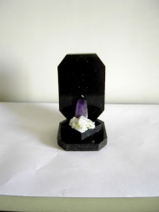
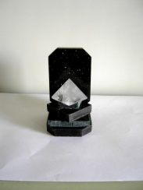
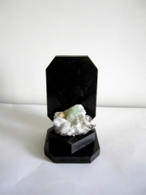
MIND MANTRA TROIKA
Mind Mantra Troika comprises of 3 Miniature Sculptures - “Light,” “Healing” and “Tranquility”. They individually symbolise human experiences of self awareness, renewal and dynamic equilibrium. Collectively they symbolise a progression of emotional and mental states.
“Light” which structurally resembles a lighthouse at the water’s edge, is symbolic of a movement from darkness to illumination; to self realisation and awareness. “Light” has been crafted from marble, granite, amethyst and apophyllite & stilbite/prehnite crystals. Amethyst is a Stone of Sobriety.
“Healing” depicts triumph, with the ascension of the beneficial quartz crystal over the black basal stones representing life’s jagged edges and ups and downs.
©2007, Girijaa Upadhyay

Slide 10
MIND MANTRA TROIKA
Tranquility” is symbolized by the beautiful lotus like structure and jade like
coloration of the apophyllite. The lotus has been an important symbol in
various cultures, from Egyptian to Hindu and Buddhist. It represents purity
divinity and evolution of man’s consciousness. It stands for the various
centres, “ chakras” of consciousness in the human body. “Tranquility” has
been made with green marble and apophyllite crystals, a phylosilicate
mineral found in the Deccan basalt traps.
Dimensions of Light, Healing & Tranquility respectively :
Height: 7” Breadth: 4” Depth: 5” apprxmly.
©2007, Girijaa Upadhyay

Slide 11
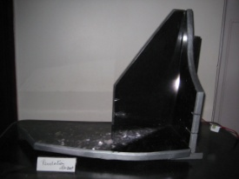
Revelation
Revelation is symbolic of a New Religion, devoid of dogmas, symbols, edicts, speaking only the language of humanity. It has however used forms that resemble the conventional symbols of religion, such as the tablets or books , folded hands and the beaming light representing the illumination of the mind and spirit , of the Divine. The tablets are however blank. The black pearl granite provides the effects literally, for the scattered pearls of wisdom and enlightenment..
Dimensions: Height: 18” Breadth: 20” Depth: 8” apprxmly.
©2009, Girijaa Upadhyay

Slide 12
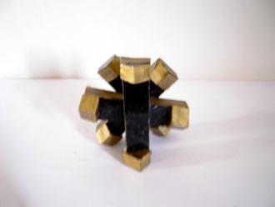
CHOTU & FRIENDS
“Chotu and friends “is a projection of the innocence and fun associated with childhood. It is an icon of camaraderie; of a sense of unity despite diversity and friendship in times of disharmony. It is evocative of the spirit of fun, of children at play, innocence and loyalty.
“Chotu and friends” is visualized as a communicator of a social philosophy. Behind the protective Chotu (or little one), are his inquisitive buddies, curios about what may happen?! Or is Chotu trying to protect them after some mischief? They share a history of fun and friendship and hopefully, a future, in a divisive world.
Copyright © 2007 Girijaa Upadhyay

Slide 13
CHOTU & FRIENDS
This sculpture was accepted as an entry for INDEX: Award 2009, a global competition for Design for improving the quality of life, in the Community /Play category. A community meeting cum play place was designed around Chotu and friends, a symbol of the virtues of camaraderie and friendship in a divisive world. The sketch of the landscape of the community meeting place designed around Chotu & Friends.follows .
Dimensions: Height: 20” Diameter: 24” apprxmly.
(Black granite)
Copyright © 2007 Girijaa Upadhyay

Slide 14
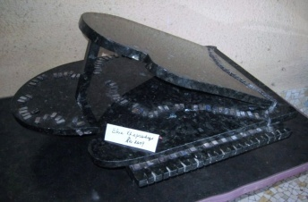
Blue Rhapsody
Blue Rhapsody shows a playful interaction between the Musical Instrument, here a Grand piano variant and the Musical Notes. The musical notes symbolised by the romping piano keys, come into their own, almost taking over (or rather walking over) the music and the instrument. The keys break out into a variety of melodies, as would be evident from the different arrangements of the notes/keys from waltz to cool jaaz. On a more serious note it also shows the supremacy of sound over the instrument- of sur (note) over saaz, (musical instrument) of the ‘absolute’ pristine nature and invincible position of a musical note. Blue Rhapsody is the first of the artist’s Sur and Saaz pair of sculptures.
Dimensions: Height: 14” Breadth: 22” Depth 13”
©2009, Girijaa Upadhyay

Slide 15
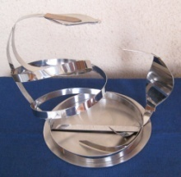
Jive
“Jive” depicts both the charmer and the charmed viz. the Snake and the Been under the magical spell of the musical notes. The Been is a wind instrument , traditionally used by snake charmers to make the snakes sway. Jive is part of the Sur and Saaz series of my sculptures, depicting the invincible- ultimate power of the Note or Sound (nad in sanskrit). Here both the characters -the Snake and the Been, are enthralled captors, as they move to the music- the Ultimate Charmer!
Jive is made from stainless steel with bits of copper for embellishment.
Dimensions: Height: 12” Breadth: 16” Depth: 12”
©2010, Girijaa Upadhyay

Slide 16
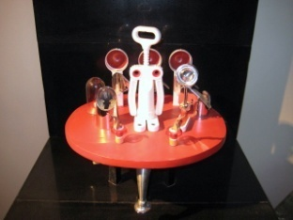
His Excellency from Gastronimica
His Excellency, Gelato from the planet Gastronmica in the Andromeda
galaxy, has just landed on Earth. He is flanked by his General and his
Minister for Alien Affairs. Also in the entourage are the IGIR ( Inter
galactic intelligence robots). The two small pilots scanning the horizon for
security are reported to be equivalent to 10000 earth radars and some
50000 secret service agents. His Excellency who is inspecting the guard of
honour presented by Earth, is secretly pleased with this antiquated
protocol! His mission to pave the way for greater intergalactic exchange of
information on gourmet cuisine styles, it would appear has started with the
right flavour!
Installation Dimensions: Height: 24” Breadth: 24” Depth: 24” apprxmly.
©2009, Girijaa Upadhyay

Slide 17
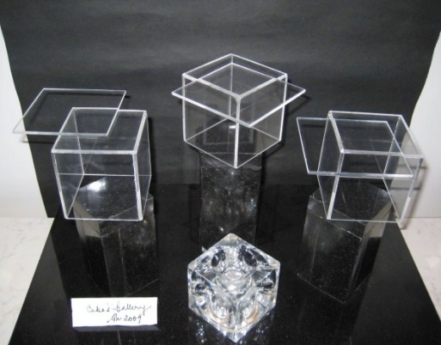
Cubes Gallery
This sculpture plays with the cubic and four sided forms. The squares, rectangles and the cubes are like acrobats in action, freezing for a brief moment – in view of the thundering applause they are receiving.
Dimensions: Height: 12” Breadth: 18” Depth: 12”
©2009, Girijaa Upadhyay

Slide 18
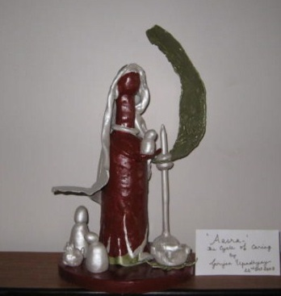
Aasra
“Aasra “is symbolic of the reinforcement of life through giving. The shooting rod with a shade providing leaf represents the young, springing with life, now caring for the Mother. The allegory also is symbolic of life - man, animal and plant, flourishing under the Earth’s bounty and Man’s reciprocal gesture, of nurturing that which gives him Life. Structural depiction of this cycle is portrayed by the circular alignment of the shade providing leaf and the nurturing shelter - providing - odhni /shawl of the Mother, read Earth.
Dimensions: Height: 18” Breadth:12” Depth: 9”
( Medium-clay )
©2008, Girijaa Upadhyay

Slide 19
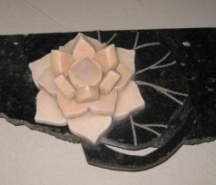
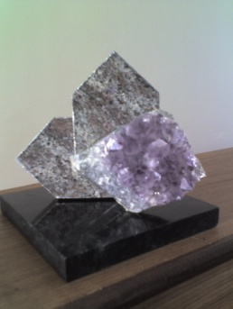
Lotuses
Lotus- an icon of beauty, purity, divine wisdom; a spiritual symbol in Hinduism and Buddhism . Lotus 1 and Lotus 2 are the first two in the Lotus series of sculptures.
Lotus 1 Padma & Patra is a presentation of the pink lotus and the equally fascinating lotus leaf, the bouyant scaffold for the plant, as unsullied by the muddied waters, as the flower. Pink makrana and green marble & rose quartz for the seed pod have been used for this creation.
Dimensions: Height: 5” Breadth: 9.5” Depth: 9.5”
Lotus 2, Utpala is a stylistic presentation of a blue lotus (lily) bud that is just opening. Granite and amethyst geode have been used for this creation.
Dimensions: Height: 5” Breadth: 4” Depth: 4”
©2007, Girijaa Upadhyay

Slide 20
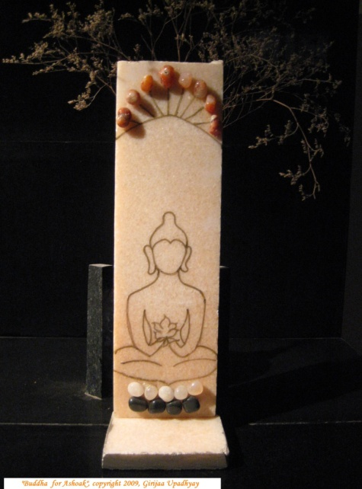
Buddha for Ashoak
Buddha outlined on pink makrana marble, the tumbled stones representing
The Four Noble Truths
The Five Precepts
and
The Noble Eightfold Path
in
Buddhism
©2009 Girijaa Upadhyay

Slide 21
……… and the journey
continues………….
Thank You.
© Girijaa Upadhyay . All Rights Reserved.
This presentation is intended for the designated recipient and purpose only This presentation and its contents are not to be reported or copied or made available to others.

Slide 22
ΔΩ¶॥ଐ୭≈•√¤θΩδ≪≫♪♬∞
From the Artist’s sketchbooks-
Some of proposed Compositions - Visual amalgams of scientific motifs, human condition & experiences, of supremo uno-Nature, of Mind and Matter.
The Dark Room - Collage in acryllic and metal
Water For Life Series – Mixed media- acryllic and clay,
Multi media , digital art and acryllic
The Revellers - Sculpture in acryllic/metal
Jal yatra- -Multi media- Collage in metal, wood;
inspired by Smetana’s Die Moldau
Endeavours - pen and ink on paper
& ……….
©2010 Girijaa Upadhyay

